Slide 1
Methodology for Pattern Discovery, Validation, and Hypothesis Development from the Annotated Biological Web
Mahmuda Khan

Slide 2
Goal
To obtain training data – sentences from the literature – to validate patterns involving triplets of Arabidopsis thaliana genes, GO terms and PO terms
Notes:
Example on www.google.com

Slide 3
Validation of Triplets
What is a triplet?
- (gene, GO, PO)
Arabidopsis gene
GO: Gene Ontology- universal biological process (BP) or cellular component (CC) or
molecular function (MF)
PO: Plant Ontology- plant structure

Slide 4
Examples of Triplets
- (HAP1 , pollen tube guidance, sperm cell)
- (SEP1, DNA binding, carpel)
- (PFS2, petal morphogenesis, stamen)
- (AP1, protein binding, shoot apex)
- (PHOT1, vacuole, cauline leaf)

Slide 5
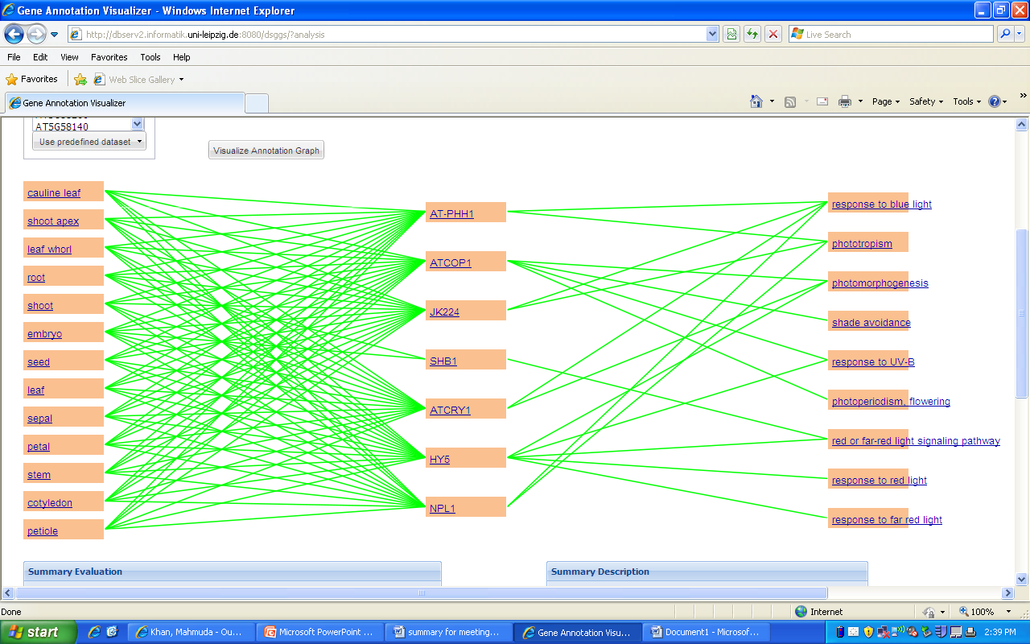
Photomorphogenesis Genes
http://dbserv2.informatik.uni-leipzig.de:8080/dsggs/?analysis
http://pattaran.umiacs.umd.edu

Slide 6
Flowering Time Genes
http://dbserv2.informatik.uni-leipzig.de:8080/dsggs/?analysis

Slide 7
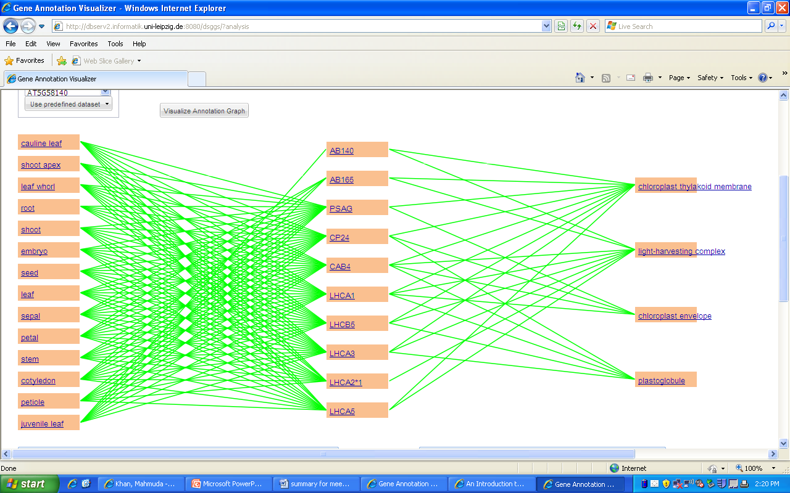
Photosynthesis Genes
http://dbserv2.informatik.uni-leipzig.de:8080/dsggs/?analysis

Slide 8
Example of imprints for triplets
(AG, sequence- specific DNA binding transcription factor, stamen)
AG encodes a transcription factor of the MADS-box family that is expressed in stamen and carpel primordia.
The MADS-box transcription factor AGAMOUS (AG) is an important regulator of stamen and fruit identity as well as floral meristem determinacy in a number of core eudicots and monocots.
The Arabidopsis homeotic gene AGAMOUS (AG) is necessary for the specification of reproductive organs (stamens and carpels) during the early steps of flower development.
The floral homeotic C function gene AGAMOUS (AG) confers stamen and carpel identity and is involved in the regulation of floral meristem termination in Arabidopsis.

Slide 9
Example of imprints for doublets – Padmini – please provide some examples
(AG, sequence- specific DNA binding transcription factor, stamen)
AG encodes a transcription factor of the MADS-box family that is expressed in stamen and carpel primordia.
The MADS-box transcription factor AGAMOUS (AG) is an important regulator of stamen and fruit identity as well as floral meristem determinacy in a number of core eudicots and monocots.
The Arabidopsis homeotic gene AGAMOUS (AG) is necessary for the specification of reproductive organs (stamens and carpels) during the early steps of flower development.
The floral homeotic C function gene AGAMOUS (AG) confers stamen and carpel identity and is involved in the regulation of floral meristem termination in Arabidopsis.

Slide 10
What Mahmuda did:
Read scientific articles.
Retrieved imprint sentences for about 136 triplets and doublets.
Participated in an experiment to determine the effectiveness of Manjal (automated) retrieval of the imprint sentences.

Slide 11
Thanks for listening ☺

